Slide 1

Lecture 9: Logic I
Monday 6:30-9:00
EAS 230

Slide 2
How to Solve AI Tasks?
Lecture 2&3
Lecture 4-7
Lecture 8-9
Lecture 10-13
Constraint satisfaction problem (CSP)
Search problems
Logic
MDP
Bayes Networks
Deep learning
State-based models
Variable-based models
“Virtual Assistant”
Reflex
"low level AI"
"high level AI"
Handles complicated logics
Reflex
Reflex
Machine learning
Notes:
[whiteboard]
evaluation allows you to estimate the value of particular policy
this lecture will be about learning, RL is not one algorithm, it refers to a family of algorithm
allows you to either explicitly or implicitly estimate MDP, and you can use the inference algorithm to figure out the optimal solution
[whiteboard]
we have a set of states, from every state we have a set of actions coming out, actions take us to the chance nodes.
out of the chance nodes are transitions, it also has reward

Slide 3
Overview of Lecture 9
Constraint solving problem
Propositional Logic
Reflex
Reflex
Machine learning

Slide 4
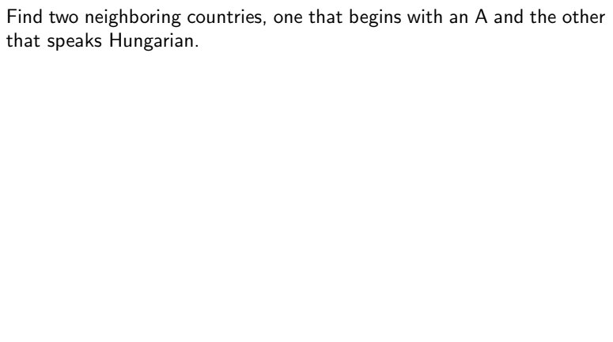
Question
Reflex
Reflex
Machine learning

Slide 5
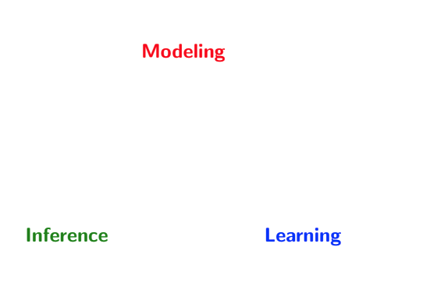
Paradigm

Slide 6
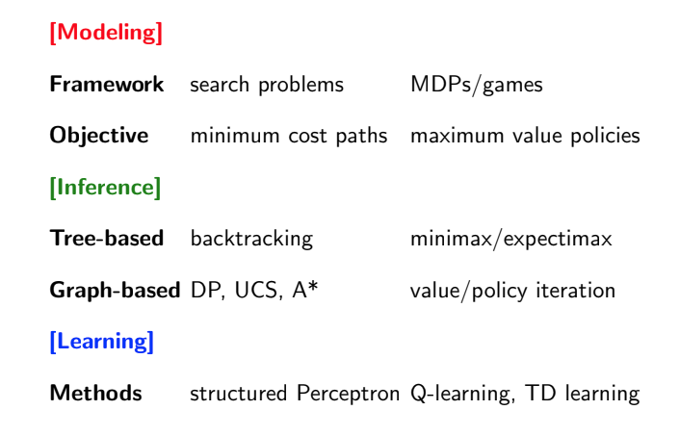
State-based models
MBMC, MFMC, SARSA, Q learning
Notes:
For state based models,
for modeling we talked about

Slide 7
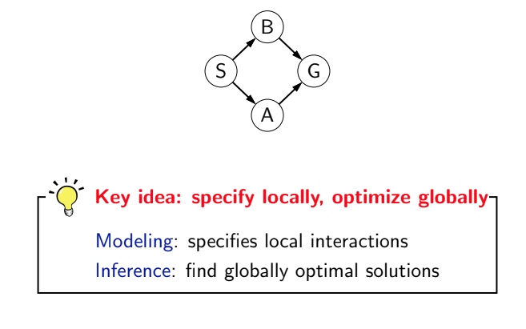
State-based Models: Takeaway 1
9
7
6
5
Notes:
There are two takeaways from state-based models:
During modeling, we had local relations, e.g. the cost.
The goal is to do inference globally, e.g., finding the minimum cost path

Slide 8
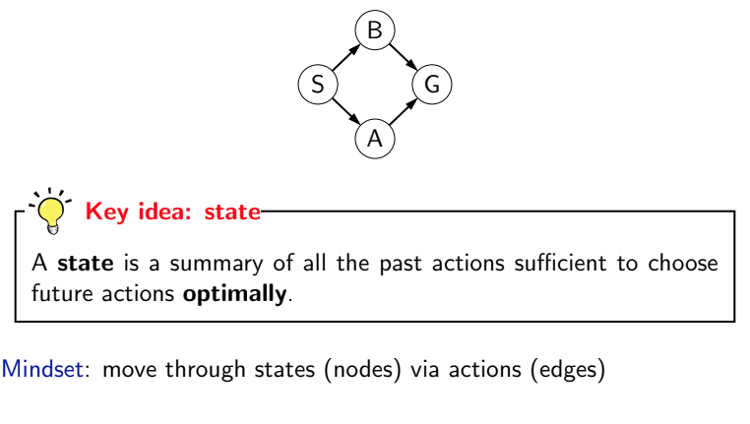
State-based Models: Takeaway 2
Notes:
The 2nd takeaway is the definition of state, which is what makes the state-based models efficient

Slide 9
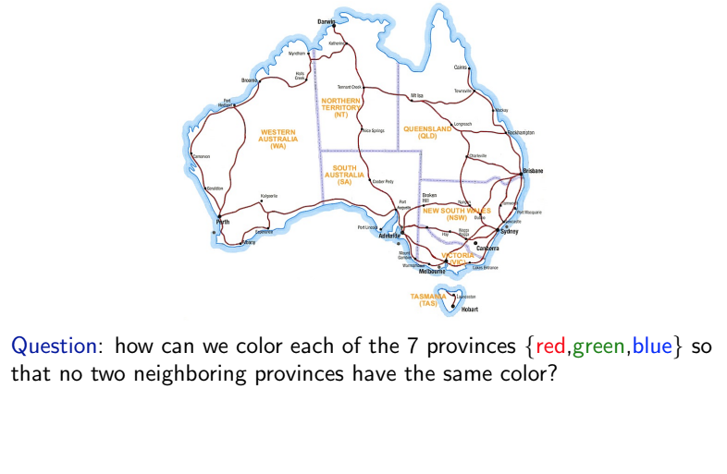
Map coloring example
Notes:
Let’s say it’s Australian
the idea is the order of things doesn’t matter, not like search (path)

Slide 10
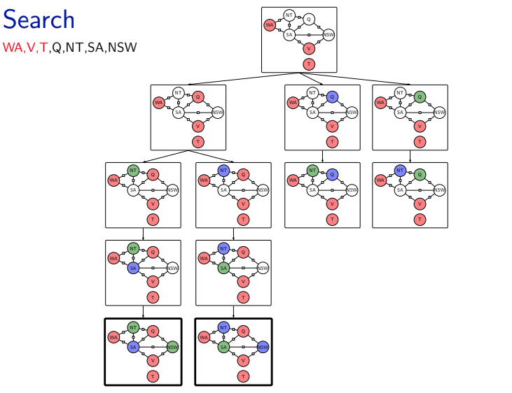
Map coloring: Backtracking search
Notes:
we can solve this problem starting from a partial solution
we can just use the abbreviations to represent each state

Slide 11
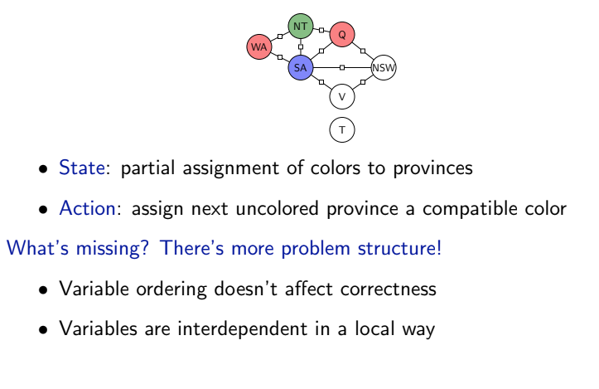
As a search problem
Notes:
in search the state is the partial assignment of colors
[state, action]
You can certainly use search to solve this problem
but search may be a bit inefficient, the question is can we do better?
because the order doesn’t matter, we can dynamically choose a better ordering for the assignment which makes the algorithm more efficient

Slide 12
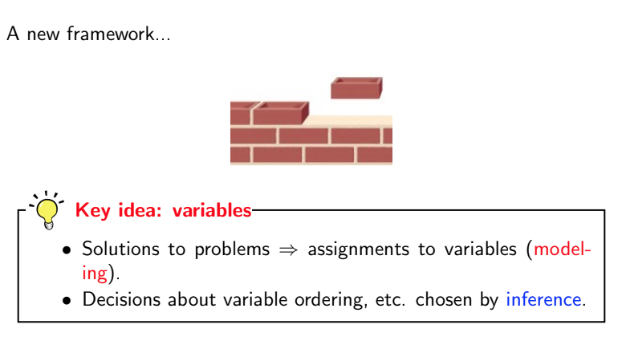
As a search problem
Notes:
To allow this more efficient algorithm, we’ll have this new framework which is based on variables instead of states.
The whole job is to pick up what the variables are, and what’s the assignment
push to inference
adhoc way: assembly, state based (higher level abstraction): c++, variable: python

Slide 13
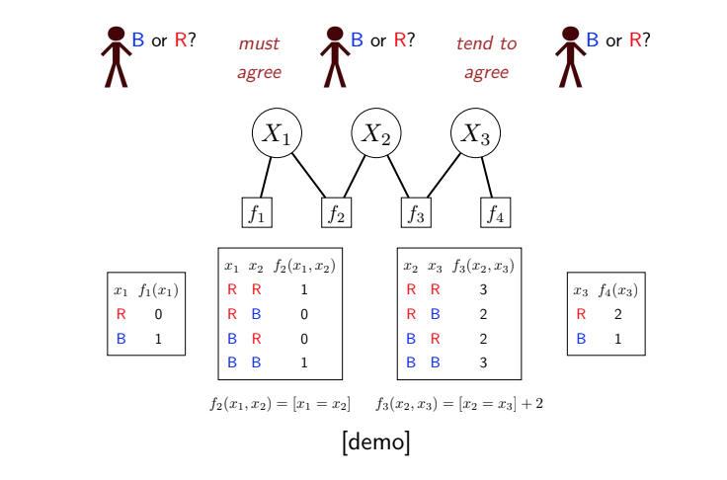
Factor graph
Notes:
I can look at the value of the factor graph

Slide 14
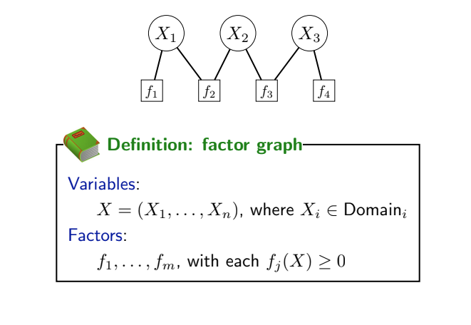
Factor graph
Notes:
Here’s the formal definition of
each xi lies in a domain
each factor is a function …

Slide 15
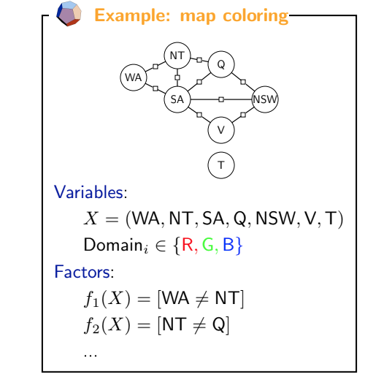

Slide 16
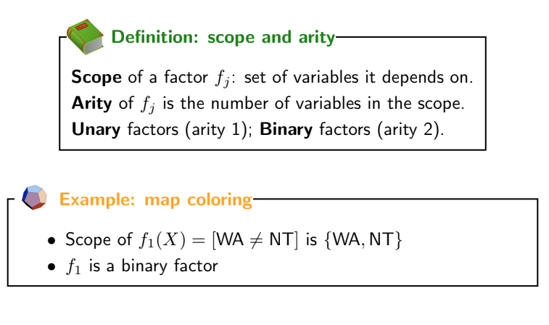
Factors

Slide 17
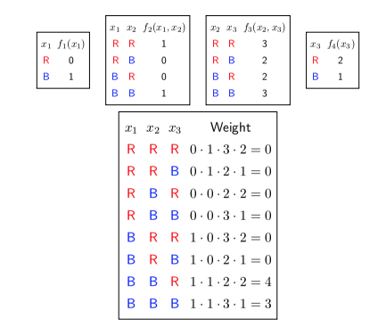
Assignment weights
Notes:
a solution is called an assignment, which specifies the value of each variable
In this setting, the maximum weight assignment is (B, B, R), which has a weight of 4. You can think of this as the optimal configuration or the most likely outcome.

Slide 18
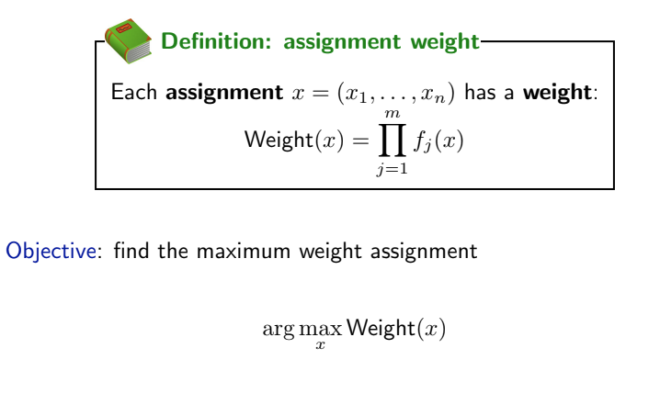
Assignment weights

Slide 19
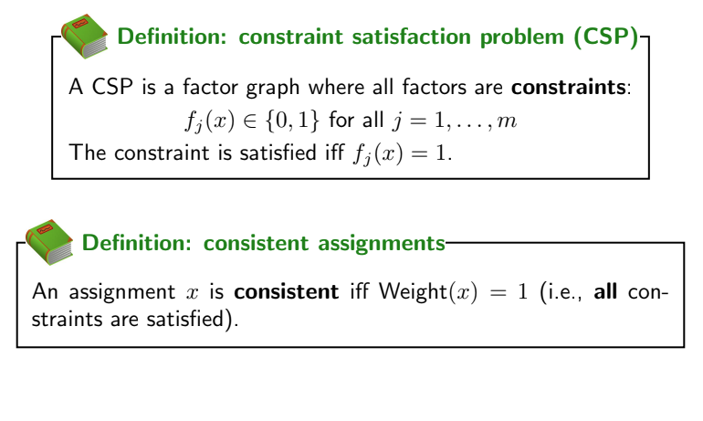
Constraint satisfaction problem
Notes:
now we are going to talk about csp, which is just factor graph
constraints of csp is just the variable in factor graph
consistency of csp is the weight in factor graph (1 or 0)
next, we want to solve the csp problem to pick the variable that’s consistent, make all factors 1, how to do that?

Slide 20
Dynamic ordering?
Random order
Random value
No lookahead checking of constraints
Notes:
We just saw that the map coloring problem can be solved using backtracking search.
but this was inefficient, can we make the search more efficient? we will see how we can make the search more efficient with 3 improvement steps: forward checking, choosing the order of variable, and choosing the order of value

Slide 21
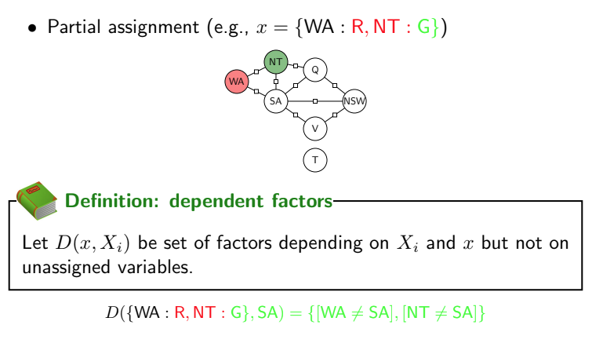

Dependent factors
Notes:
Before we talk about the 3 tricks we’ll first need to define one terminology.
[draw this on the whiteboard]
D(x, X_i) x: partial assignment, X_i: the current variable, e.g., X_i = SA

Slide 22
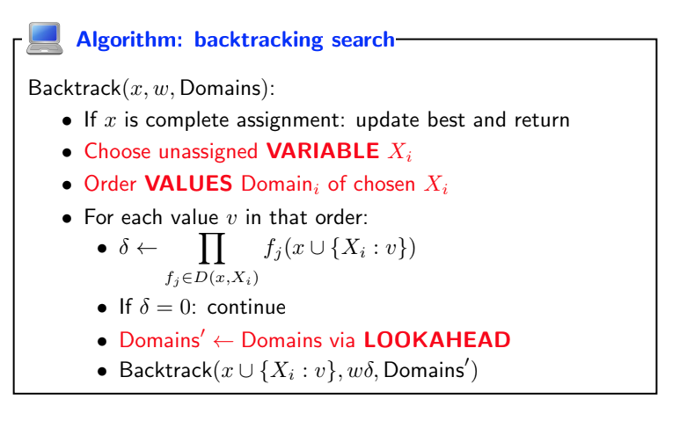
Backtracking search
How to order?
How to order?
One step lookahead
Notes:
Now we can layout the backtracking search and point out the 3 steps we want to improve
update the domain

Slide 23
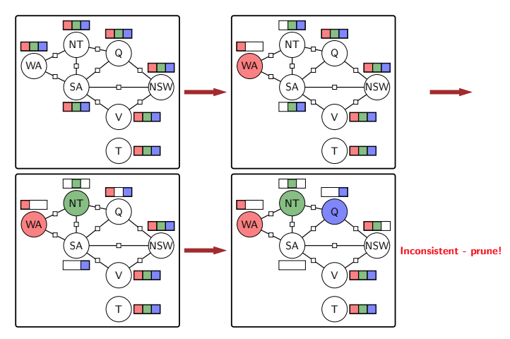
Forward checking (example)
Notes:
this shows one step lookahead of eliminating values
for some reason we choose Q instead of SA next
We can see that the selection between Q and SA can be improved by ordering of which variable to choose

Slide 24
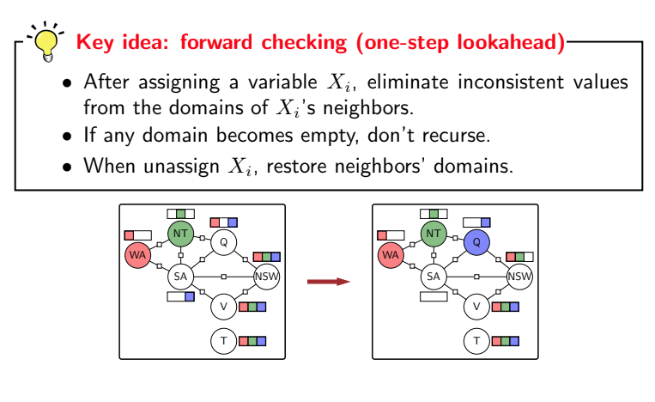
Forward checking

Slide 25
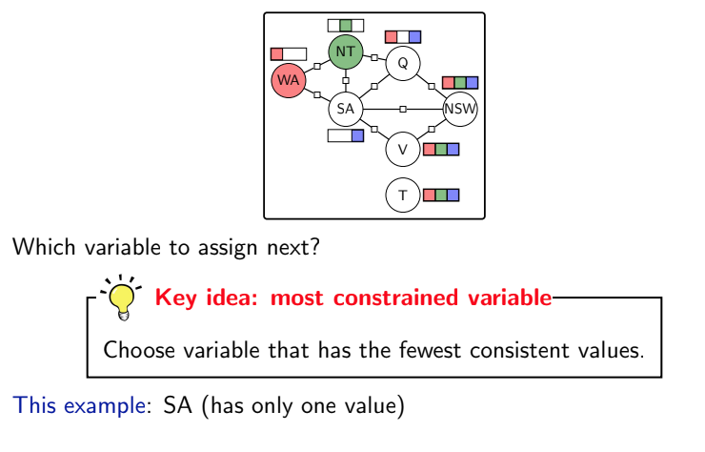
Choosing an unassigned variable
Notes:
Why do we want to choose the variable with the least possible values?
if you want to fail you want to fail early

Slide 26
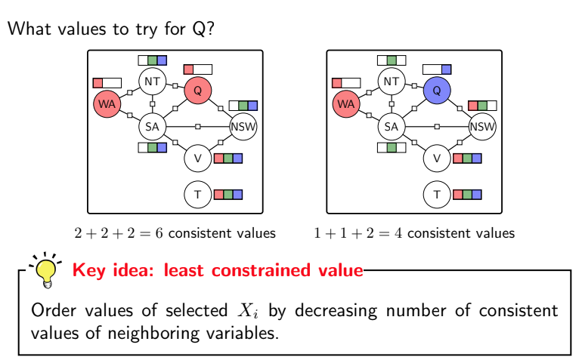
Order values of a selected variable
Notes:
For value you want to pick the value such that there is the most number of variables
why the difference? because for choosing of variable it’s the AND, for choosing of colors it’s the OR

Slide 27
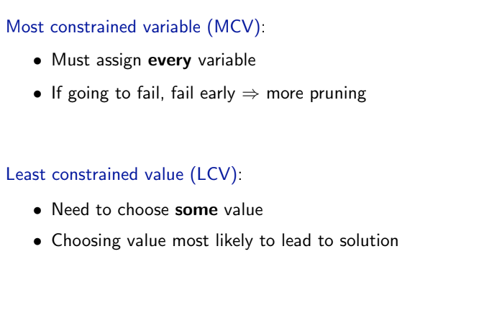
Ordering variables vs ordering values

Slide 28
Summary of CSP
Backtracking search: inefficient
Abstraction: Variable-based models
Variable-based framework
Factor graph
Constraint satisfaction problem
Three steps to improve Backtracking
Choosing the most constrained variable
Choosing the least constrained value
Forward checking: one step lookahead

Slide 29
Overview of Lecture 9
Constraint solving problem
Propositional Logic
Reflex
Reflex
Machine learning

Slide 30
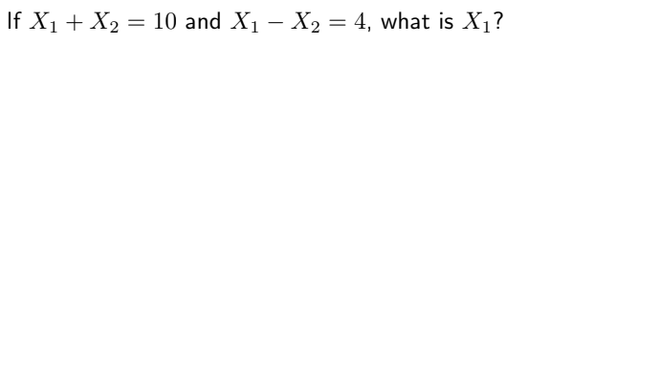
Question
Reflex
Reflex
Machine learning
Notes:
what’s the point
notice this is a factor graph, you could use backtracking search of x1 x2, but clearly this is not the efficient way to do it
there’s structure we can leverage to arrive at the answer easier
how you can do logical inference to arrive at answers much faster?

Slide 31
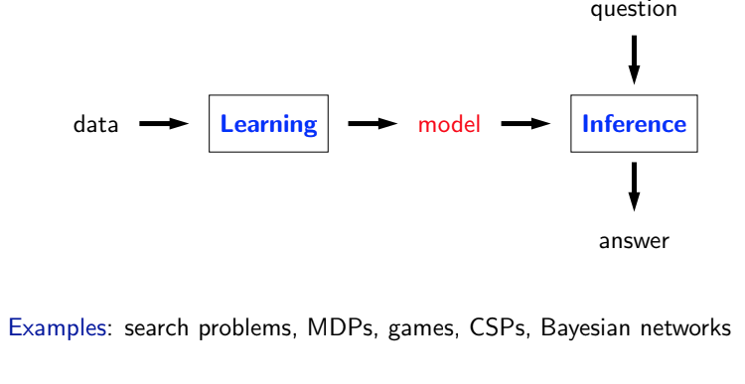
Paradigm
Reflex
Reflex
Machine learning
Notes:
the data, we perform some learning on it, and got a model, and use it for inference
so what does it look like for differen..
for search, what’s the minimum cost path
in mdp, what’s the maximum value policy
in csp, what’s the maximum weight assignment?
for each case we looked at the modeling and inference algorithm, MLE, RL algorithm, structured perceptron and so on
depending on what type of model, there are different learning algorithms, inference algorithms

Slide 32
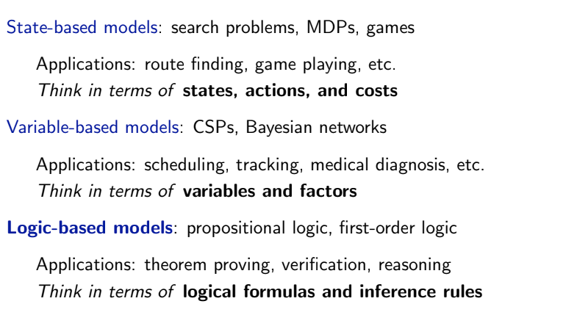
Paradigm
Reflex
Reflex
Machine learning

Slide 33

Motivation: smart personal assistant
Reflex
Reflex
Machine learning
Notes:
lying on the beach and talk to an assistant (data in star trek)

Slide 34
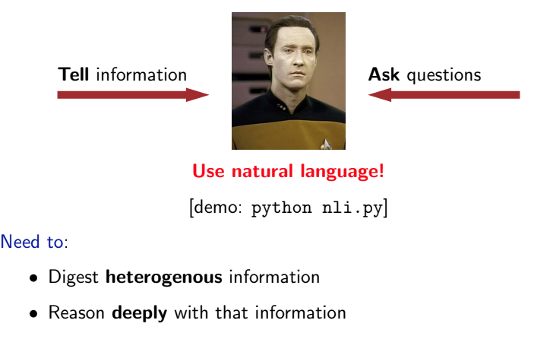
Motivation: smart personal assistant
Reflex
Reflex
Machine learning
Notes:
have an assistant answer questions
[demo]
Garfield is a cat.
The system needs to digest…

Slide 35
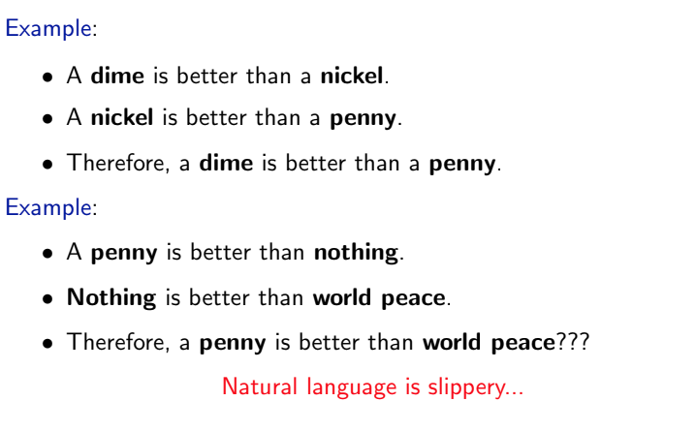
Natural language interface?
Reflex
Reflex
Machine learning
Notes:
This is because natural language is not very precise

Slide 36
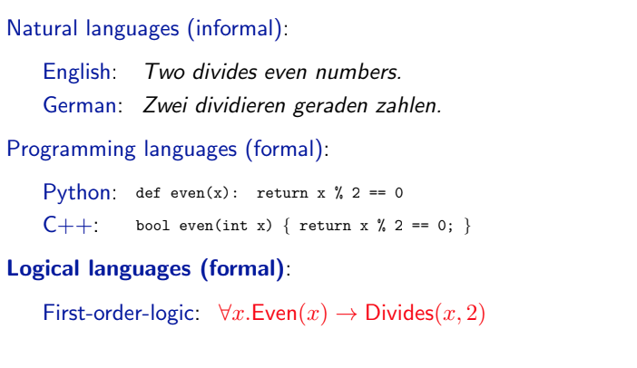
Language
Reflex
Reflex
Machine learning
Notes:
if we step back and talk about what’s the role of NL, the language itself is a mechanism for expression
there are many types of language, nL, pl
we’ll be talking about one type of language which is logical language. It’s formal. but like NL, it’s declarative. There’s a 1-to-1 isomorphism between NL and logic language.

Slide 37
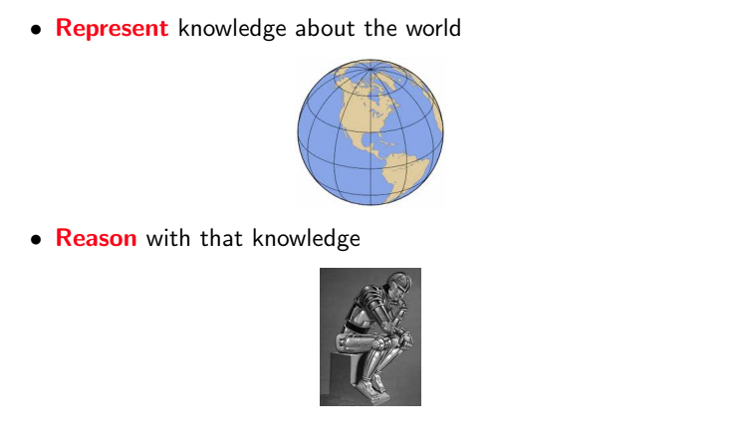
Two goals of logic language
Reflex
Reflex
Machine learning

Slide 38
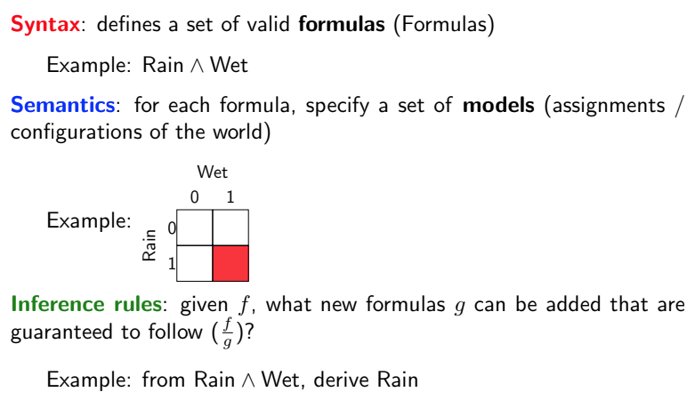
Ingredients of logic
Reflex
Reflex
Machine learning
Notes:
syntax defines what kind of expressions are valid or grammatical
semantic for each expression what does it mean, means something very precise
inference rules allow you to take various formulas and do operations on them

Slide 39
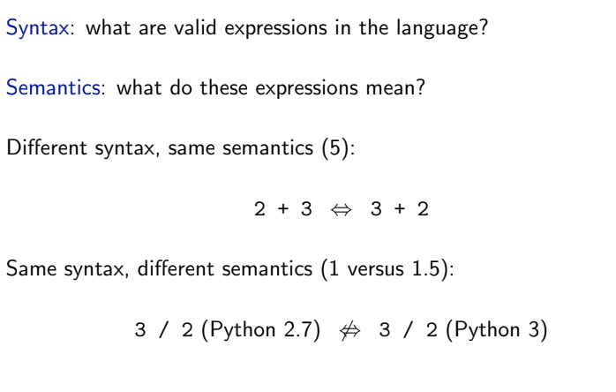
Syntax vs semantics
Reflex
Reflex
Machine learning
Notes:
here’s an example of two expressions which are different syntax but same semantics
in order to define language you not only have to specify syntax but also semantics

Slide 40
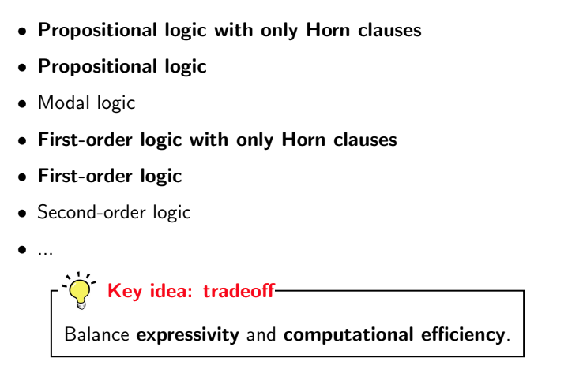
Logics
Reflex
Reflex
Machine learning
Notes:
there are bunch of different logic.
as with most models, there’s a tradeoff between expressivity and computational efficiency
as we go down this list, the first order logic and beyond, will explore more and more things using the language, but it’ll be harder to do computation using that language

Slide 41
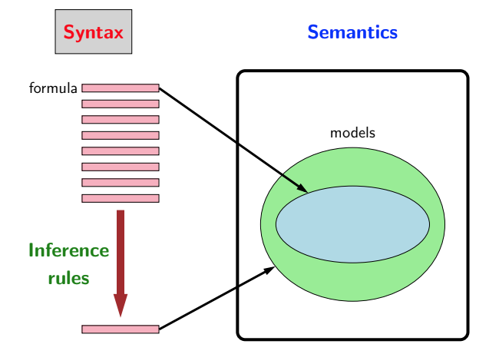
Propositional logic
Reflex
Reflex
Machine learning
Notes:
this is the key diagram for today and next lecture
we first have syntax then semantics and inference rules

Slide 42
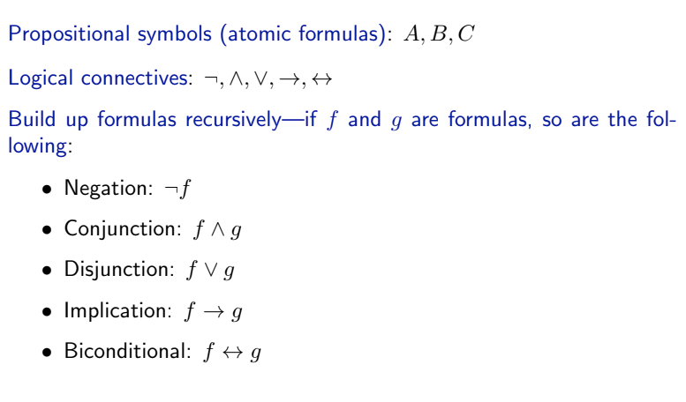
Syntax of propositional logic
Reflex
Reflex
Machine learning
Notes:
capital, formulas that cannot be any smaller
bidirectional implies

Slide 43
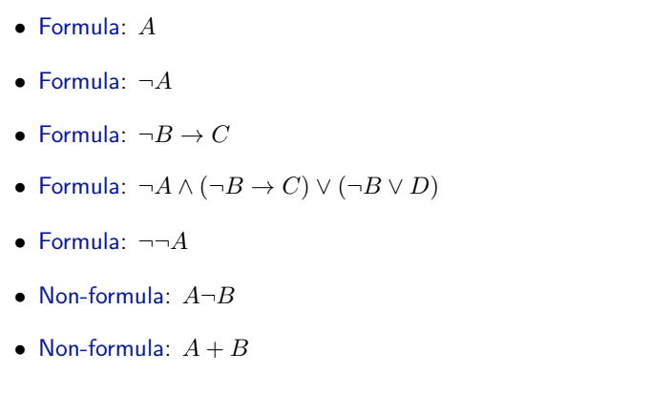
Syntax of propositional logic
Reflex
Reflex
Machine learning

Slide 44
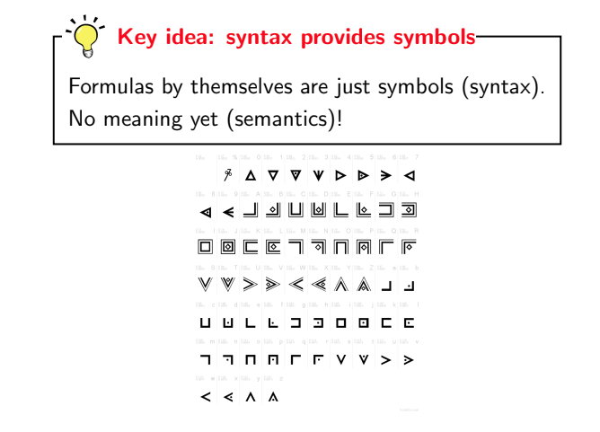
Syntax of propositional logic
Reflex
Reflex
Machine learning
Notes:
syntax gives you formulas or statements you can make
not is just a symbol, or is just a symbol, they don’t have any semantics
i can define some semantics which will be completely different from you’ve imagined

Slide 45
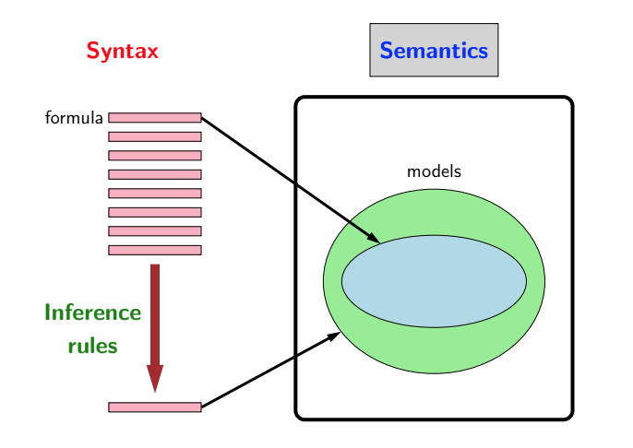
Propositional logic: semantics
Reflex
Reflex
Machine learning
Notes:
the syntax gives you the set of formulas/statements you can make
now I’ll have to tell you what do these things mean

Slide 46
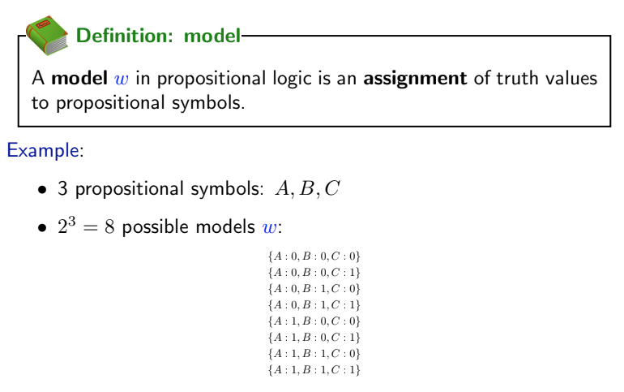
Semantics definition: model
Reflex
Reflex
Machine learning
Notes:
semantics there are a number of definitions.
the first is model, it’s really confusion but from standard literature
different from general notion of a model, e.g., hmm
refers to an assignment of truth value for propositional symbols
use w because sometimes it’s also called world

Slide 47
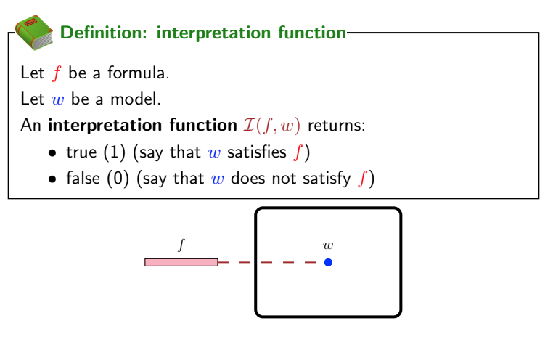
Interpretation function
Reflex
Reflex
Machine learning
Notes:
the interpretation function takes a function and the model and say “if the world looks like this, is the statement true?”

Slide 48
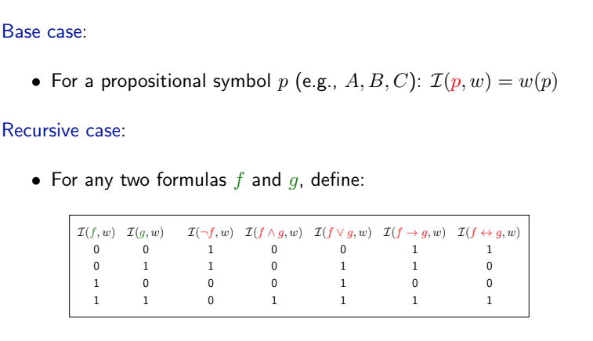
Interpretation function: definition
Reflex
Reflex
Machine learning
Notes:
just to explain the interpretation, I’ll define it recursively
for propositional symbols p, just gonna interpret as look up. So if asking “is A true”? go to my model and look up if A’s true
recursively can define the interpretation of any formulas in terms of its sub formulas
suppose I have the interpretation of f and g, if f is 0 and g is 0

Slide 49
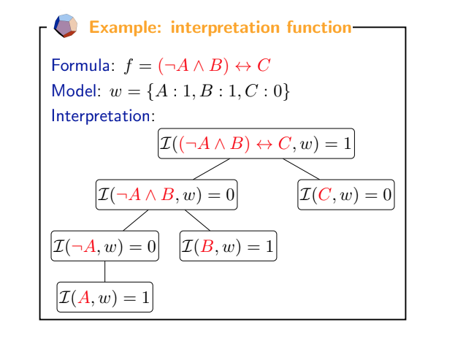
Interpretation function: example
Reflex
Reflex
Machine learning
Notes:
interpretation function binds formulas which are syntax, and semantics which are models

Slide 50
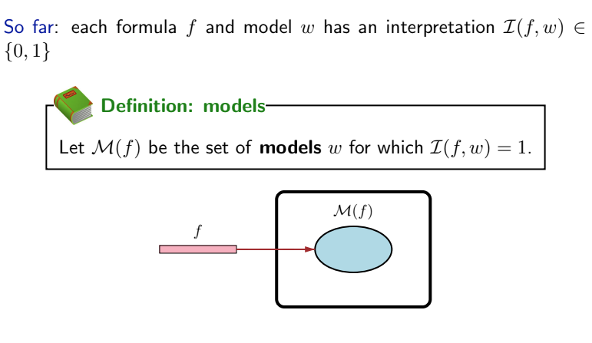
Formula represents a set of models
Reflex
Reflex
Machine learning
Notes:
it’s useful to think about formulas in a slightly different way
we’ll think about a formula as representing the set of all models for which interpretation is true (1)
M (f) is a set of models that f is true
if I make a statement here what I’m really saying is I think the world is one of these models not the other models

Slide 51
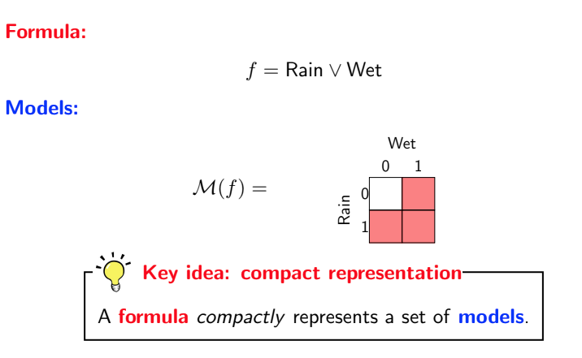
Formula represents a set of models: example
Reflex
Reflex
Machine learning
Notes:
the set of models is the red region, which are 3 possible models
the key idea here is remember I said logic allows you express complicated and large things by using very small means
here I have a very small formula, that represents a set of models which can be exponentially large, power of logic comes from this

Slide 52
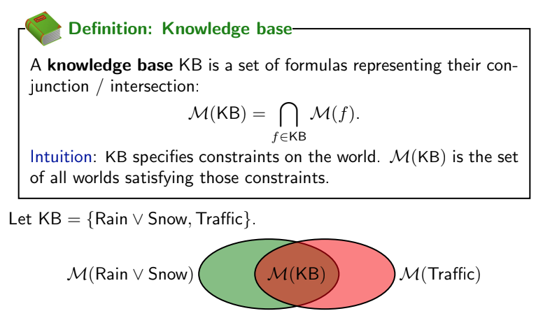
Knowledge base
Reflex
Reflex
Machine learning
Notes:
another definition
KB is just a set of formulas, think of this as the facts you know about the world
the key is I’ll define a set of models denoted by KB to be the intersection of all the models denoted by the formulas
in this case, if …, the models denoted by the KB is just the intersection
initially you have 2^n possible world, as you add things to your KB, the size of the world will shrink

Slide 53
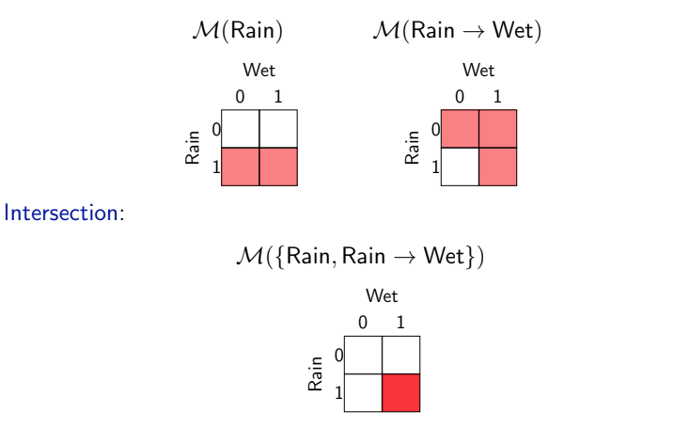
Knowledge base: example
Reflex
Reflex
Machine learning

Slide 54
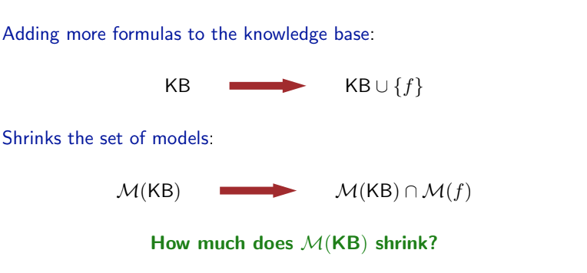
Cases of adding to the knowledge base
Reflex
Reflex
Machine learning
Notes:
as you go through life you’ll add more formulas to your KB
over time the model will shrink, bc you are taking intersection
one question is how much it’s shrinking, there are three different cases

Slide 55
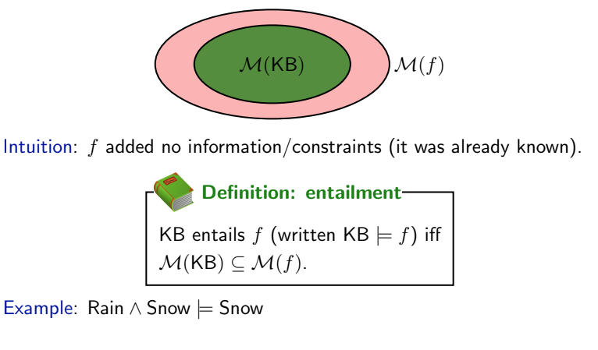
Case 1: Entailment
Reflex
Reflex
Machine learning
Notes:
the first is entailment. suppose this is your formula so far, and someone tells you this, so you didn’t learn anything
which means f is at least as large

Slide 56
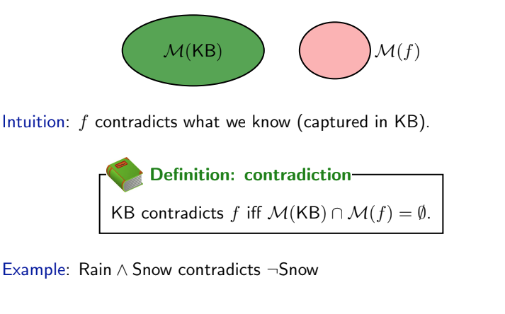
Case 2: Contradiction
Reflex
Reflex
Machine learning
Notes:
e.g., if you know it’s rain and snow, someone tells you it’s not snow

Slide 57
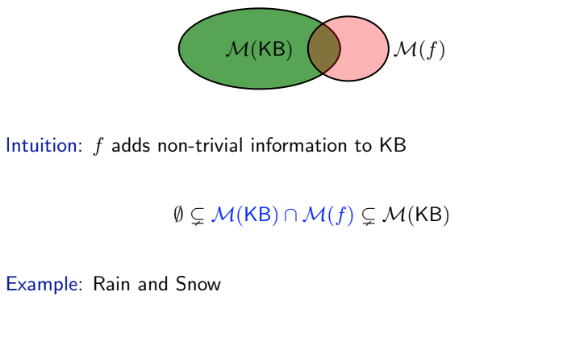
Case 3: Contingency
Reflex
Reflex
Machine learning
Notes:
I learned something new
if it’s strictly inside it’s also contingency

Slide 58

Contradiction and entailment
Reflex
Reflex
Machine learning
Notes:
there’s a relation between contradiction and entailment

Slide 59

Tell operation
Reflex
Reflex
Machine learning
Notes:
with these three notions, we can go back and think about how to implement these operations
if I have a system and I tell the system a formula f, there are three possibilities of the system responses

Slide 60

Ask operation
Reflex
Reflex
Machine learning

Slide 61

Digression: probabilistic generalization
Reflex
Reflex
Machine learning
Notes:
this is a bit of digression, in BN, we have complete assignments, and joint distribution of these assignments.
We can think of this as probabilistic, so the numerator is the probability mass of KB intersect f, and divide those from the KB.
so instead of idk, you can give a probability

Slide 62

Satisfiability
Reflex
Reflex
Machine learning
Notes:
now how do we know that given KB, whether f is entailment, contradiction or contingency?
We can reduce Ask and Tell to satisfiability calls. why we reducing to satisfiability?

Slide 63

Model checking
Reflex
Reflex
Machine learning
Notes:
for propositional logic, checking satisfiability is a special case of solving CSP
we just call propositional symbol variables, formula constraints,

Slide 64

Model checking
Reflex
Reflex
Machine learning
Notes:
in this case we have KB like this, if we find a satisfying assignment, then we return satisfiable
and we define this CSp and we find a satisfying assignment, we return satisfiable, …

Slide 65

Model checking
Reflex
Reflex
Machine learning
Notes:
DPLL: named after 4 people, essentially backtracking search + pruning
walkset think of as gibbs sampling
we now have all the ingredients for inference rules, defined symbols, formulas, semantics, told you even how to solve entailment contradition queries by reducing to satisfactabviliy

Slide 66

Propositional logic
Reflex
Reflex
Machine learning
Notes:
but now coming back at the original motivation of X1+X2, we can ask the question can we exploit the fact that we have formulas rather than arbitrary functions
this is where inference rules will come into play
I’ll explain this figure: I have a bunch of formulas, these formulas carve out a set of models, and this formula if it’s a superset, that means it’s entailed.
So far we’ve talked about is doing everything in semantics. Now what we’ll talke about is inference rules that allow us to directly operate on the syntax and hopefully get some results

Slide 67

Inference rules
Reflex
Reflex
Machine learning
Notes:
here’s an example of making inference.
read…
so I’m gonna write this there’s a set of premises which I know is true, I can derive a conclusion which is another formula
this is a general rule called modus ponens, it says for any propositional symbol p and q, that entails q.

Slide 68

Inference framework
Reflex
Reflex
Machine learning
Notes:
then I can add g

Slide 69

Inference algorithm
Reflex
Reflex
Machine learning
Notes:
i have a set of inference rules
will repeat until there’s no change to the KB, choose the formulas from the KB. If I find matching rule that exist, simply add the the KB.
another definition I’ll make here is derive and prove, which means given the KB and inference rules I can produce f given the rules.
This is in contrast of entailment, which is defined by the models of KB and the models of f.
This is just mechanically applying the rules
[demo]

Slide 70

Inference example
Reflex
Reflex
Machine learning
Notes:
you can’t derive rain implies slippery which is true but modus ponens is too weak for that

Slide 71
References
Pascal Poupart (2018)
CS 885 — Reinforcement learning
University of Waterloo
Percy Liang and Dorsa Sadigh (2019)
CS221 — CS221: Artificial Intelligence: Principles and Techniques
Stanford University

